Slide 1
Using Quantum Computers
Barry C. Sanders
Quantum Information Summer School
15-18 July 2019
Institute of Business Administration Karachi

Slide 2
What is computation?
A [universal] computer is a [programmable] machine that process input information (bits) into output information (bits) via a logical sequence of hardware instructions.
Computation is the physical process in this machine, determined by an algorithm, whose purpose is to solve a computational problem.
Computational problems arise as different types, including ”decision”, “function”, “search”, “promise” and ”optimization”.

Slide 3
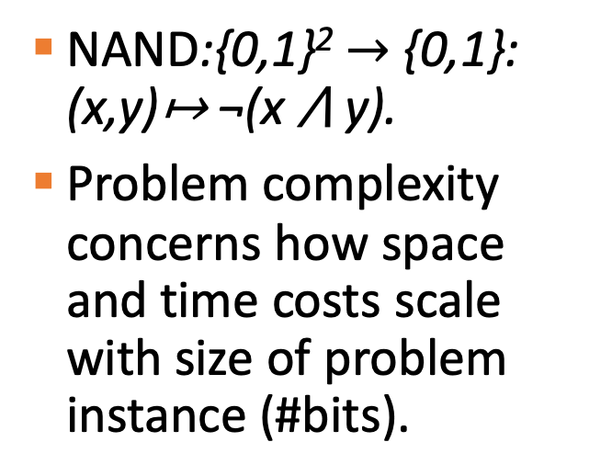
Decision problems
Map bits to a single bit (Yes/No).
Boolean function f:{0,1}*→ {0,1}.
Boolean function decomposable into NAND gates.
NAND:{0,1}² $→$ {0,1}: (x,y)↦ ¬(x ⋀ y).
Problem complexity concerns how space and time costs scale with size of problem instance (#bits).

Slide 4
Complexity
Space cost S
Time cost T
Given problem, complexity characterizes how S and T grow with respect to instance n, which is the number of bits required to specify the problem

Slide 5
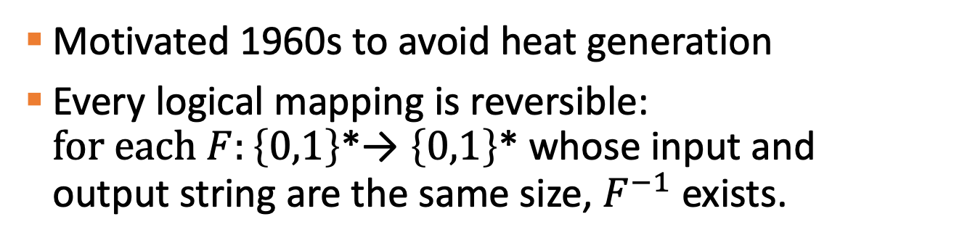
Reversible computing
Motivated 1960s to avoid heat generation
Every logical mapping is reversible: $for each F:\left\{0,1\right\}$*→ $\left\{0,1\right\}$* whose input and output string are the same size, $F^{−1}$ exists.
Fredkin Gate

Slide 6
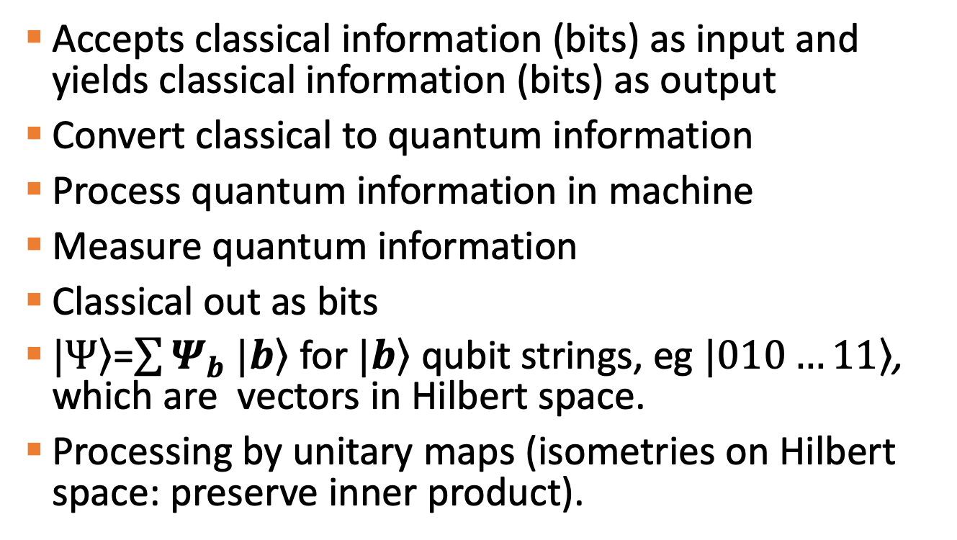
Quantum computer
Accepts classical information (bits) as input and yields classical information (bits) as output
Convert classical to quantum information
Process quantum information in machine
Measure quantum information
Classical out as bits
$\left.|Ψ\right\rangle$=$\sum{Ψ_{b}}$ $\left.|b\right\rangle$ for $\left.|b\right\rangle$ qubit strings, eg $\left.|010…11\right\rangle$, which are vectors in Hilbert space.
Processing by unitary maps (isometries on Hilbert space: preserve inner product).

Slide 7
Not really parallelism

Slide 8
Universal quantum instructions

Slide 9
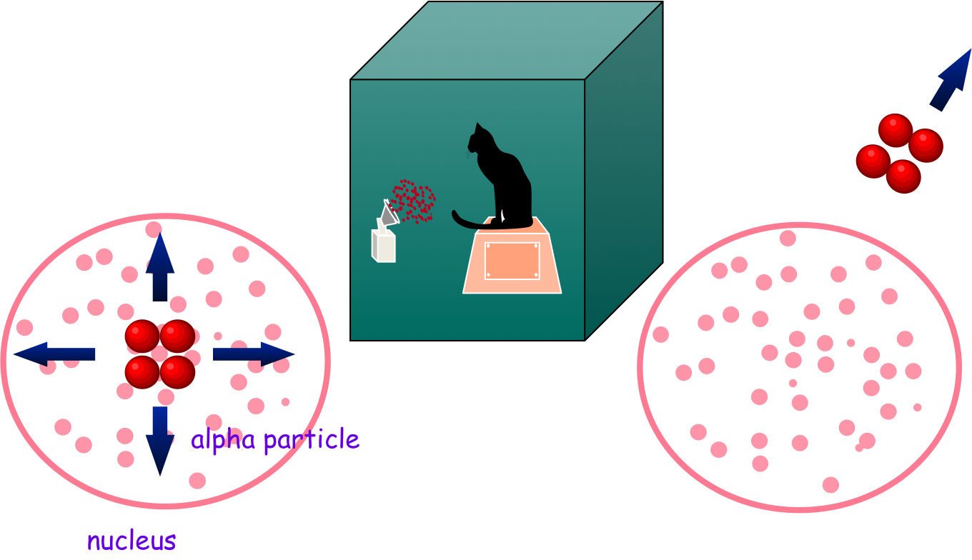
Schrödinger’s cat

Slide 10
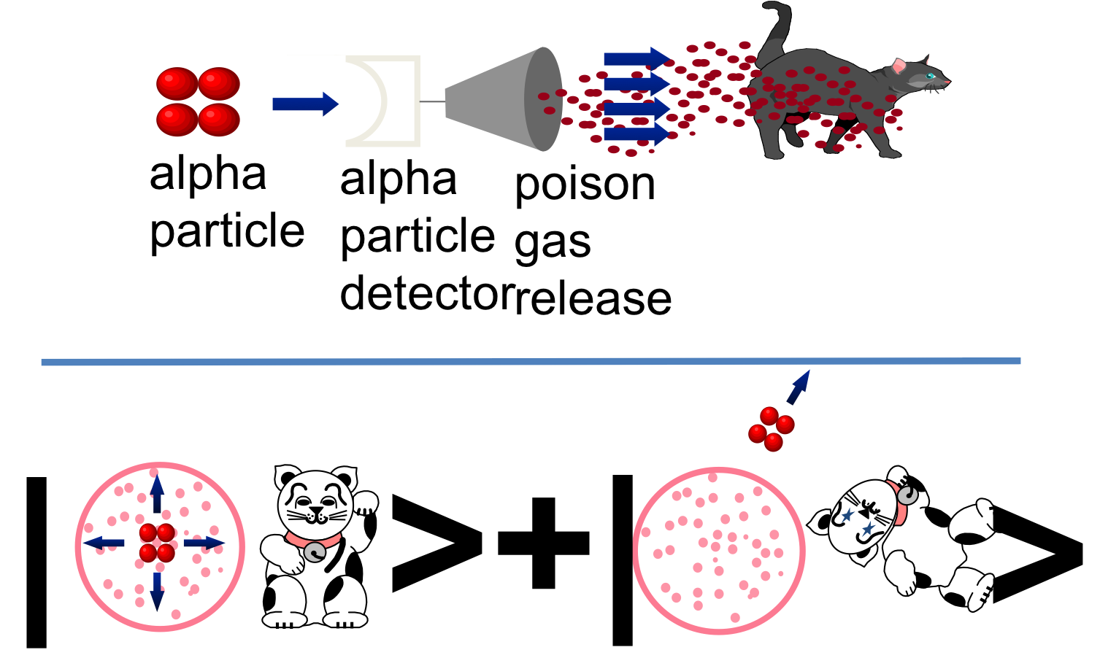
Simulating Schrödinger’s cat

Slide 11
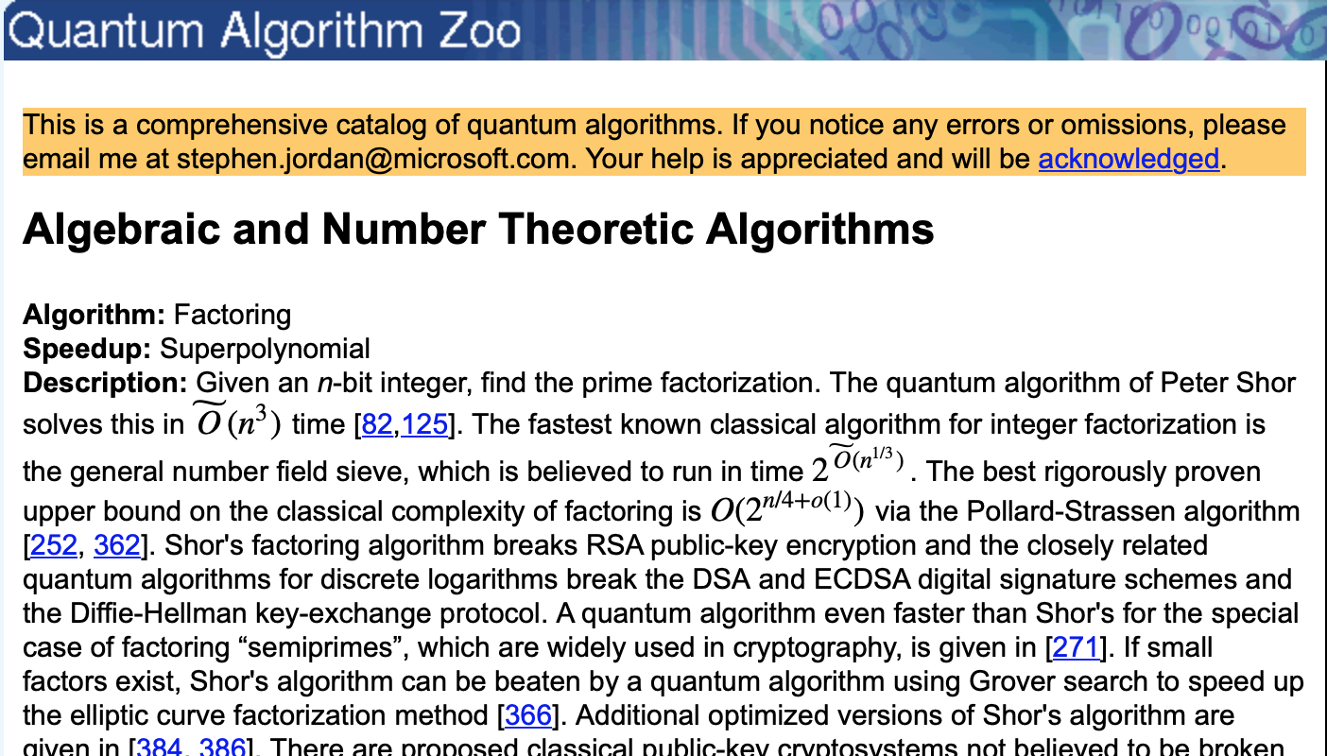
Building and using q computer

Slide 12
Physical representation of bit
Classical
Mechanical: Position of a gear or lever
Dynamic RAM: charge buildup in capacitor
Read-only memory: presence/absence of conducting pathway
Bar code
Quantum
Magnetic: electron spin or flux quantum
Energy: dipole in atom
Charge: Cooper pair left or right of junction
Light: Photon path or polarization or arrival time

Slide 13
Dealing with imperfection
Q Error Correction
Block coding: a logical qubit is represented by a few physical qubits in an entangled state
Encode to overcome exponential sensitivity to decoherence
Decode to extract answer
Fault tolerance
Each new instrument brings new errors
Fault tolerance ensures that complicating the set-up has the net effect of reducing the overall error.
Convergence from q threshold theorem

Slide 14
Using the q computer
Q algorithms
Proven quadratic speed-up such as amplitude amplification
Believed subexponential speedup for hidden abelian subgroup
Q simulation
Hamiltonian simulation for q-state input to q-state output under generic, restricted Hamiltonian (H)
Another definition refers to analogue q machine for dynamical simulation trusting H

Slide 15
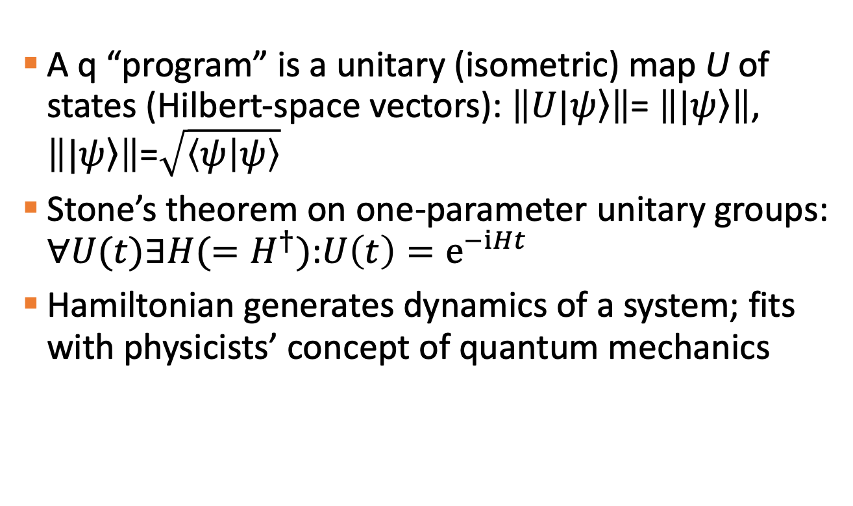
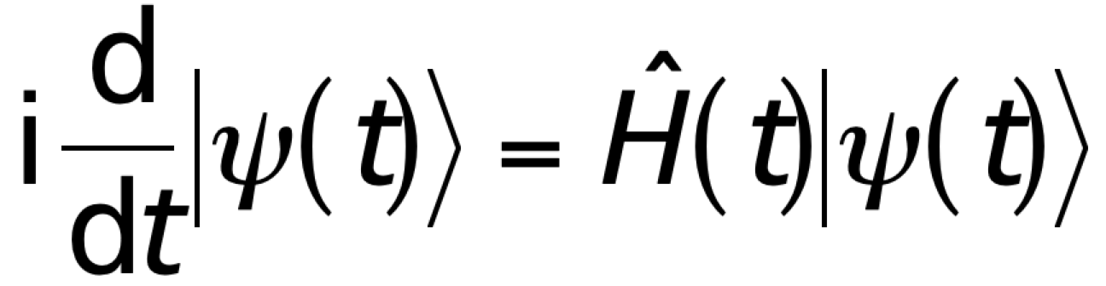
Hamiltonian H
A q “program” is a unitary (isometric) map U of states (Hilbert-space vectors): $\left\|U|\left.ψ\right\rangle \right\|$= $\left\||\left.ψ\right\rangle \right\|$, $\left\||\left.ψ\right\rangle \right\|$=$\sqrt{\left\langle ψ | ψ\right\rangle }$
Stone’s theorem on one-parameter unitary groups: $∀U(t)∃H(=H^{†})$:$U\left(t\right)=e^{−iHt}$
Hamiltonian generates dynamics of a system; fits with physicists’ concept of quantum mechanics

Slide 16
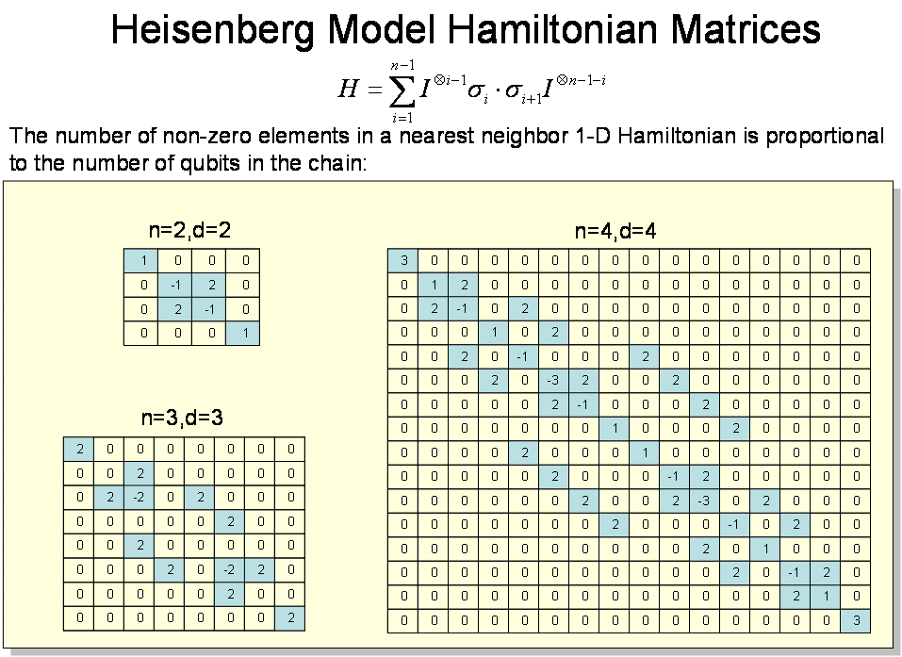

Slide 17
H as an adjacency graph
α₁
y₁
x
:
1
1
1
2
α_{d}
y_{d}
3
3
2
2
3
2
1
3
2
1
2
1
3
3
1
2
3
2
1
2
3
1
3
1
3
2
2
3
2
1
1
2
1
3
1
3
2
2
1
2
2
3
1
3
1
3
3
1
1
3
2
2
1
1

Slide 18
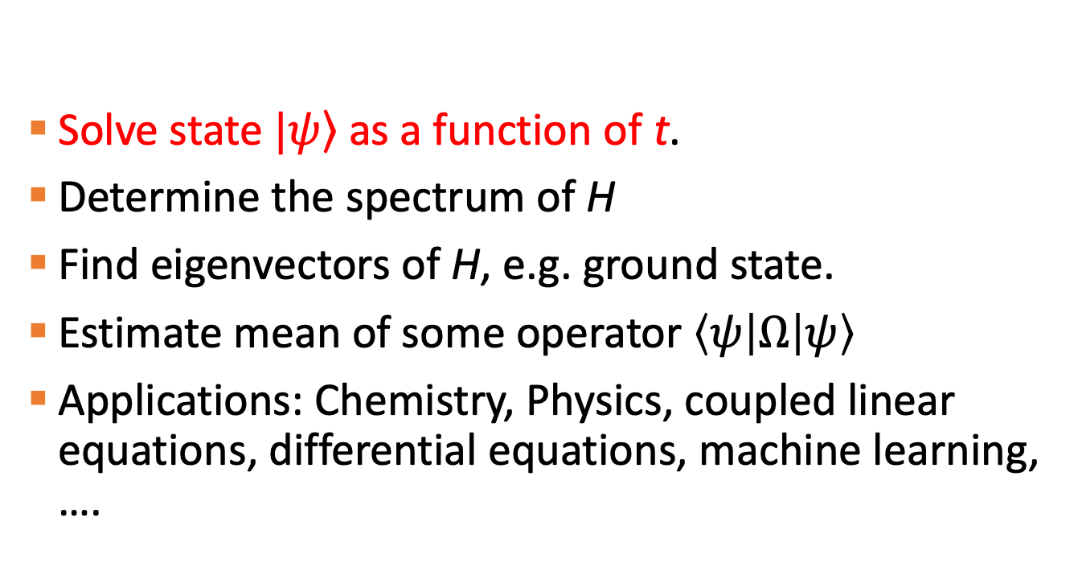
Solve Schrödinger’s Equation
Solve state $\left.|ψ\right\rangle$as a function of t.
Determine the spectrum of H
Find eigenvectors of H, e.g. ground state.
Estimate mean of some operator $\left\langle ψ | Ω | ψ\right\rangle$
Applications: Chemistry, Physics, coupled linear equations, differential equations, machine learning, ….

Slide 20

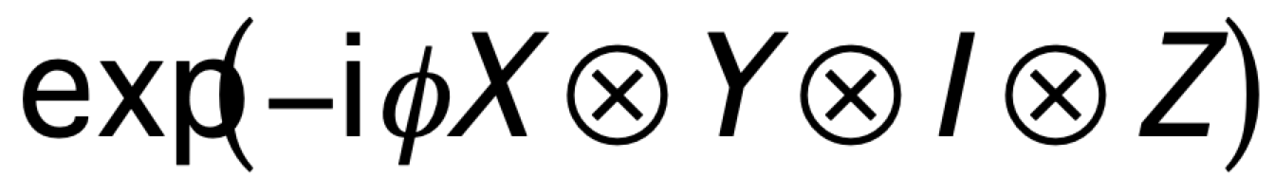
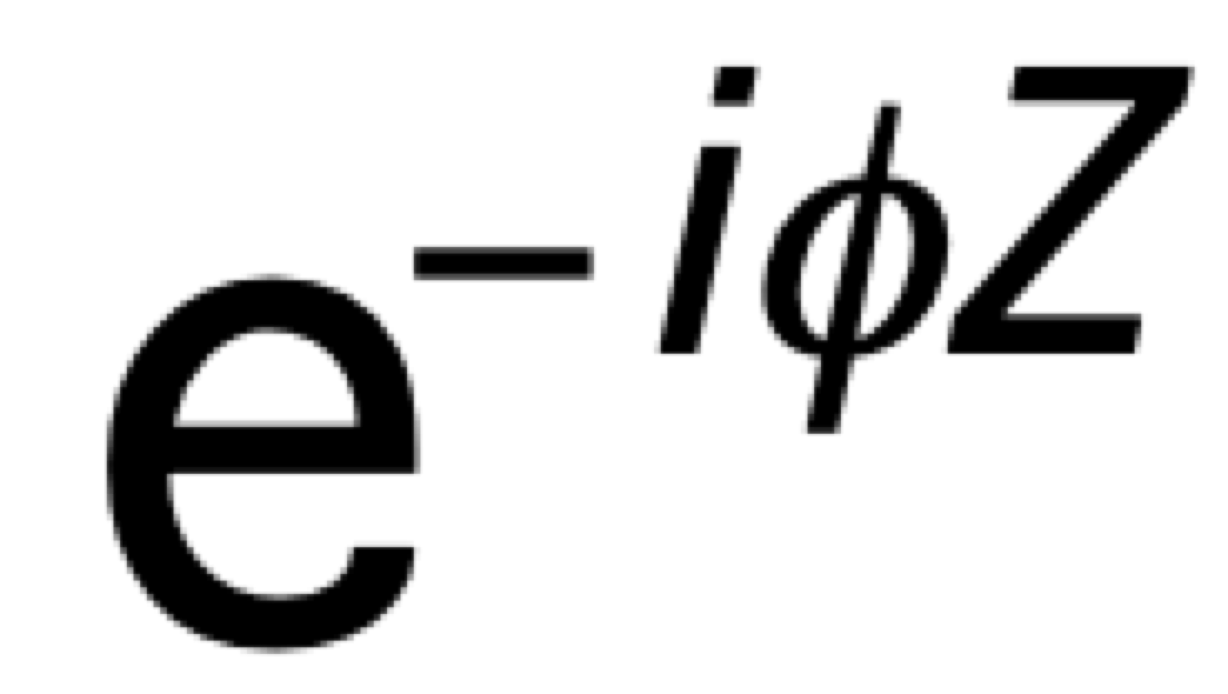
Q circuit for Pauli evolution
H
H
S⁶
H
H
S²

Slide 21
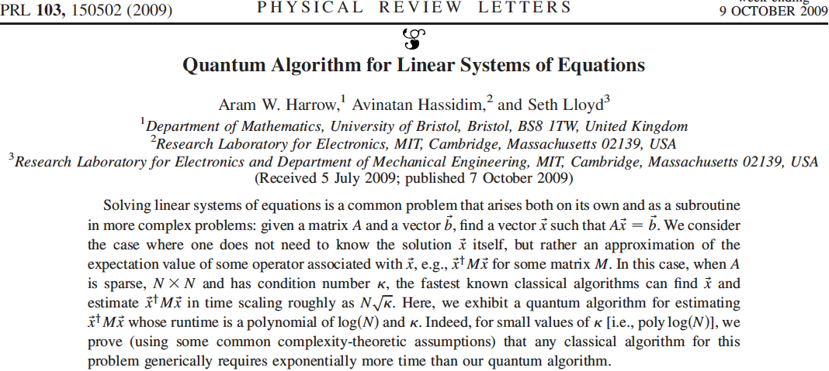
Linear-equation solver

Slide 22
Linear equations for learning
Fit model to data set
Linear regression
Regularization (regression with small coefficients).
Principal-component analysis (dimensional reduction via matrix factorization e.g. SVD*)
Latent semantic analysis for natural language processing using matrix factorization
Recommender systems
Deep learning

Slide 23

Harrow-Hassidim-Lloyd strategy
Modify Kitaev’s eigenvalue-estimation algorithm for Hermitian A
Prepare and inject $|\left.b\right\rangle$ as input
Then approximate $|\left.b\right\rangle$ in A-eigenbasis {|u_{j}>} with corresponding eigenvalues {λ_{j}}
Requires O(nlogn) steps
Kitaev q algorithm output: eigenvalues and corresponding eigenvectors of A
Then controlled rotations on $|\left.b\right\rangle$ and then undo to get $|\left.x\right\rangle$

Slide 24
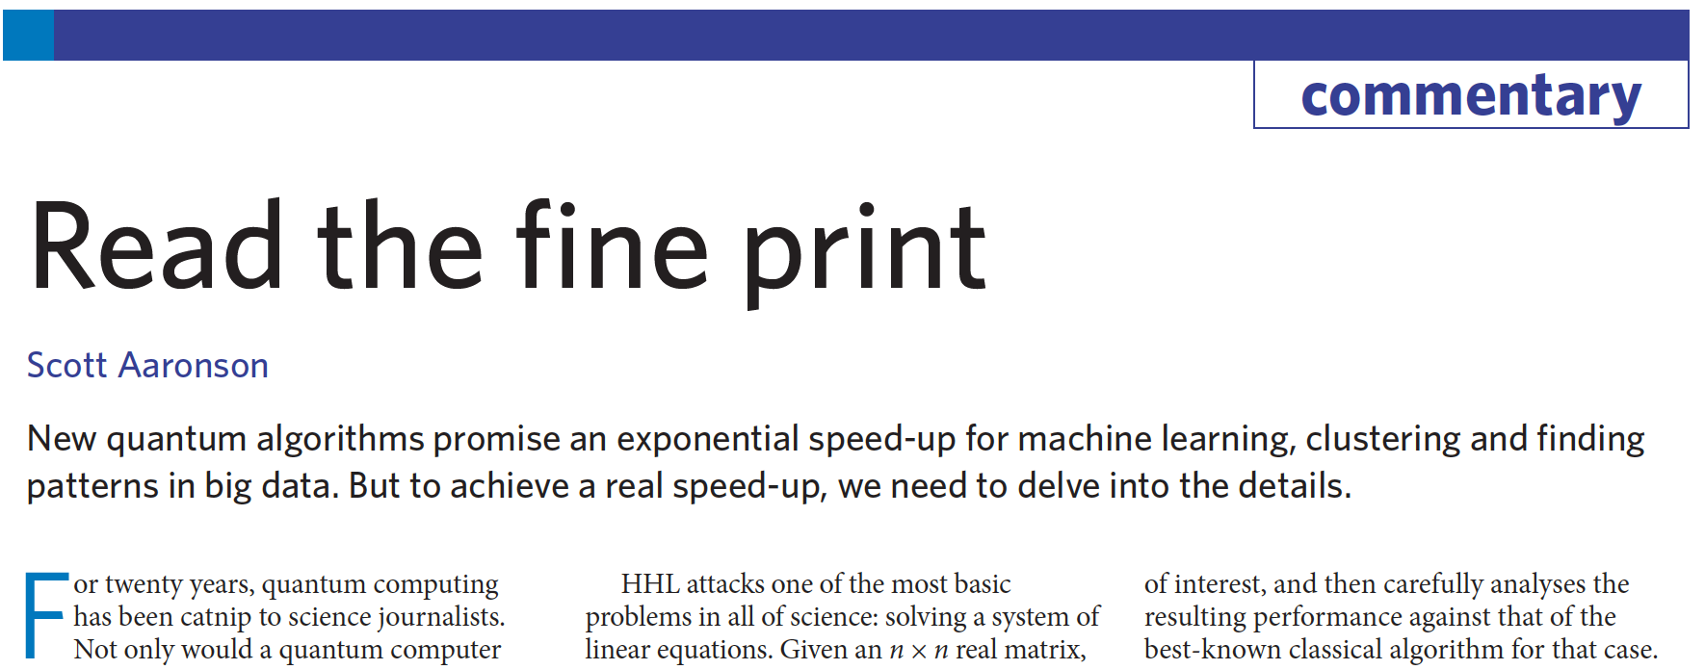
Aaronson’s Caveats

Slide 25
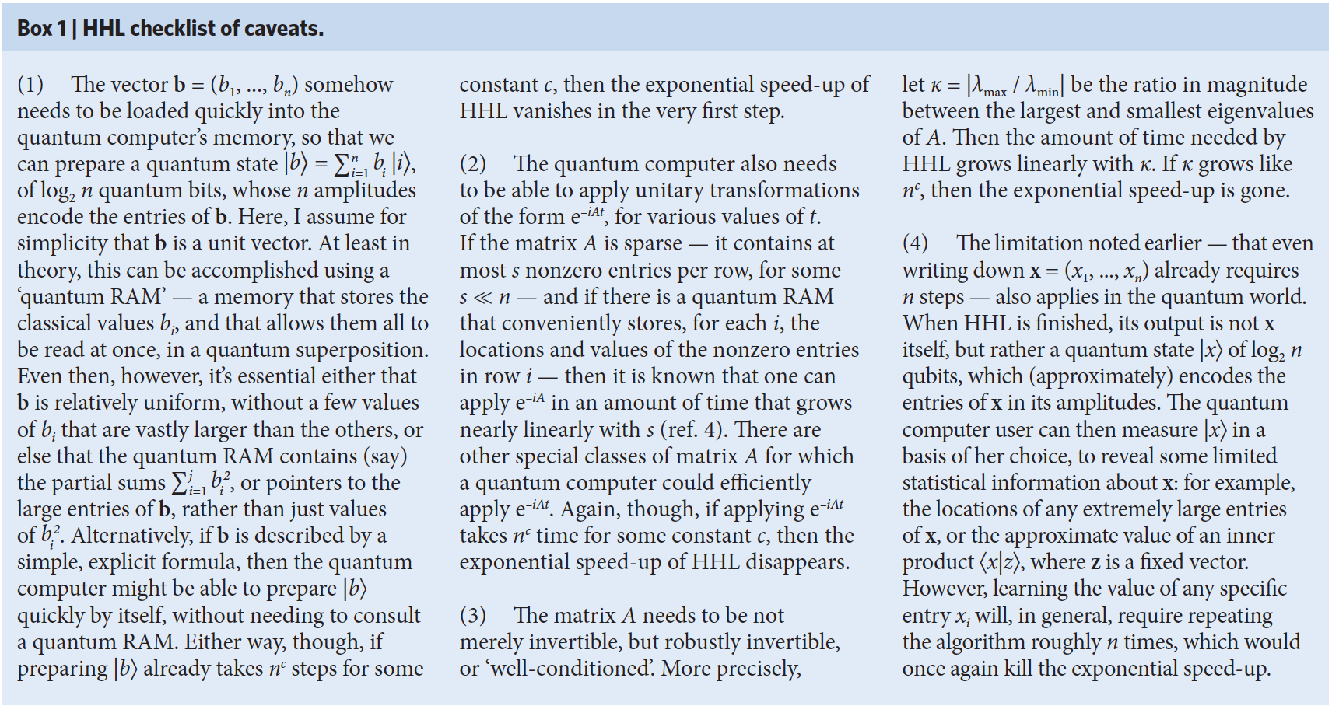
Four Caveats

Slide 26
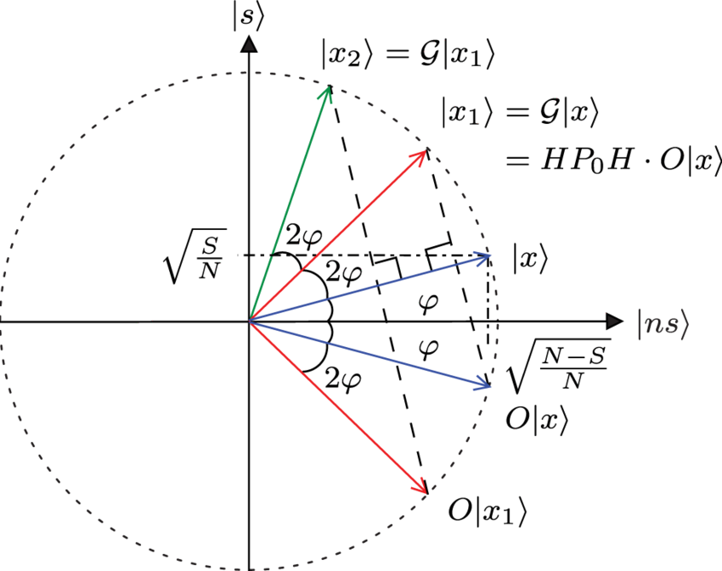
Amplitude amplification
Given output determines corresponding black-box input with high prob that yields given output
Uses √N queries for N the domain size
Quadratic q improvement

Slide 27
Hidden Abelian Subgroup
Problem
Consider group G, subgroup H, and set X
For O(log|G|+log|X|)-bit oracular hiding function f:G→X st f(g)=f(g’)⟺gH=g’H, determine generating set for H from oracular evaluations of G
Hard classically (subexponential); easy quantumly (polynomial)
Includes factoring, discrete logarithm, graph isomorphism, shortest-vector

Slide 28
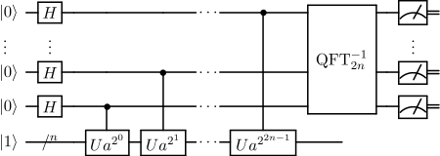
Shor algorithm

Slide 29
Quantum simulation
For sparse Hamiltonian H on n degrees of freedom, exp(-iHt) can be simulated with poly(n,t) gates whereas superpolynomial classical unless BPP=BQP
Can tractably approximate ground states for some systems and some tensor-network states
Applications to chemistry, condensed matter, relativistic q dynamics, q field theory

Slide 30
Optimization
Minimize $f\left(x\right):\left\{g_{i}\left(x\right)≤0\right\},$ $\left\{h_{j}\left(x\right)=0\right\}$.

Slide 31
Combinatorial optimization
Find optimum from a finite set of feasible solutions
Approaches are generally search algorithms
Not guaranteed to solve efficiently
Applications: machine learning, auctions, operations research, algorithms

Slide 32
Simulated annealing
Metaheuristic* to approximate global optimum
Goal: minimize energy of a system
Agent moves probabilistically from current state s to neighbor s’ or stays at s
Accept worse neighbours with low probability as a way to escape local optimal that are not global
Acceptance prob depends on energy & “temperature”
*Problem-independent strategy to guide search procedures for approximating global optima, including sim annealing, evolutionary algorithms & local searches

Slide 33
Simulated annealing

Slide 34
Cooling schedule
Temperature T corresponds to probability of accepting jumps to worse neighbouring states
Cooling must be slow to allow near-equilibrium dynamics; depends on topography and present T
Strategies for cooling include adaptive and thermodynamic approaches
Sometimes restart rather than continue from current state and temperature

Slide 35
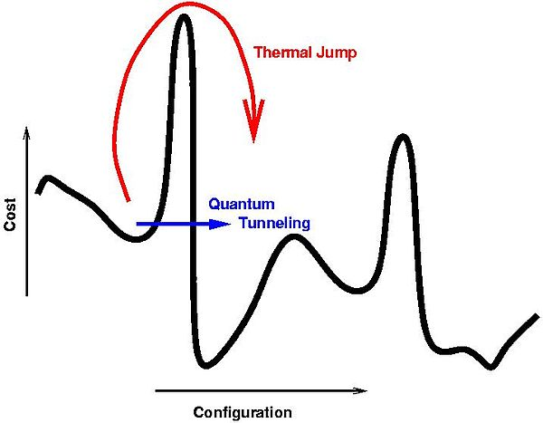
Quantum annealing
Augments temperature-driven jumps to worse neighbours with quantum tunneling through bad-neighbour regions
Typically used for combinatorial optimization problems

Slide 36
Hamiltonian
Construct problem Hamiltonian H_{p} whose ground state encodes the problem.
Start with ground state of simple Hamiltonian H₀
Cooling schedule slow compared to spectral gap

Slide 37
Boolean Satisfiability problem
Boolean expression built from binary variables, operation AND (∧), OR (∨), NOT and parentheses
Literals include variables and their negation
Conjunctive normal form:
  (x₁ ∨ ¬x₂) ∧ (¬x₁ ∨ x₂ ∨ x₃) ∧ ¬x₁
Conjunctive normal form:
3SAT:
  (l₁ ∨ l₂ ∨ x₂) ∧ (¬x₂ ∨ l₃ ∨ x₃) ∧ (¬x₃ ∨ l₄ ∨ x₄) ∧ ⋯ ∧ (¬x_{n − 3} ∨ l_{n − 2} ∨ x_{n − 2}) ∧ (¬x_{n − 2} ∨ l_{n − 1} ∨ l_{n})

Slide 38
MAX-SAT
Generalizes SAT
What is maximum number of clauses that can be satisfied in a Boolean expression?
Efficiently solved approximately but NP-Hard exactly.

